Slide 1
चरैवेति, चरैवेति
Keep progressing to attain a higher self.
avinash.bhagat@lpu.co.in Avinash Bhagat 9463281930

Slide 2
CAP275: Data Communication and Networking
Lecture 6-8
OSI Model
avinash.bhagat@lpu.co.in Avinash Bhagat 9463281930

Slide 3
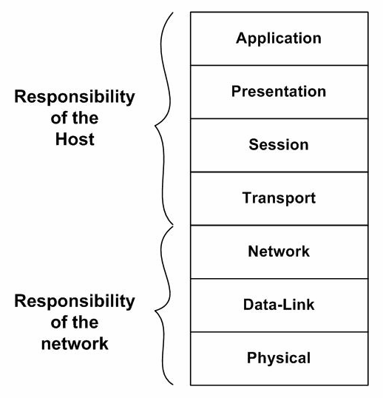
ISO’s
Open System Interconnection Architecture

Slide 4
ISO’s
Open System Interconnection Architecture
S/ W or H/W
S/W
S/W
S/W
S/W
S/W and H/W
S/W and H/W
H/W

Slide 5
ISO’s
Open System Interconnection Architecture
Devices
Gateway and firewalls operate on all the layers
Router
Layer-2 Switches , NIC &Bridge
hubs, repeaters & Ethernet cable connectors.

Slide 6
ISO’s
Open System Interconnection Architecture
PDU Protocol Data Unit
Data
Data
Data
Segment
Packet
Frame
Bits and Bytes

Slide 7
ISO’s
Open System Interconnection Architecture
Type of addresses
Specific
Port 16 bits
Logical 32 bits
Physical /link 48 bits

Slide 8
ISO’s
Open System Interconnection Architecture
Flow of Data
Process to process
End to End
Hop to Hop or node to node

Slide 9
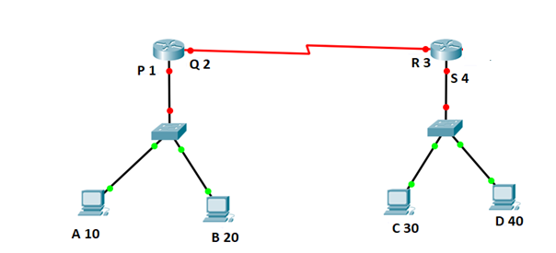
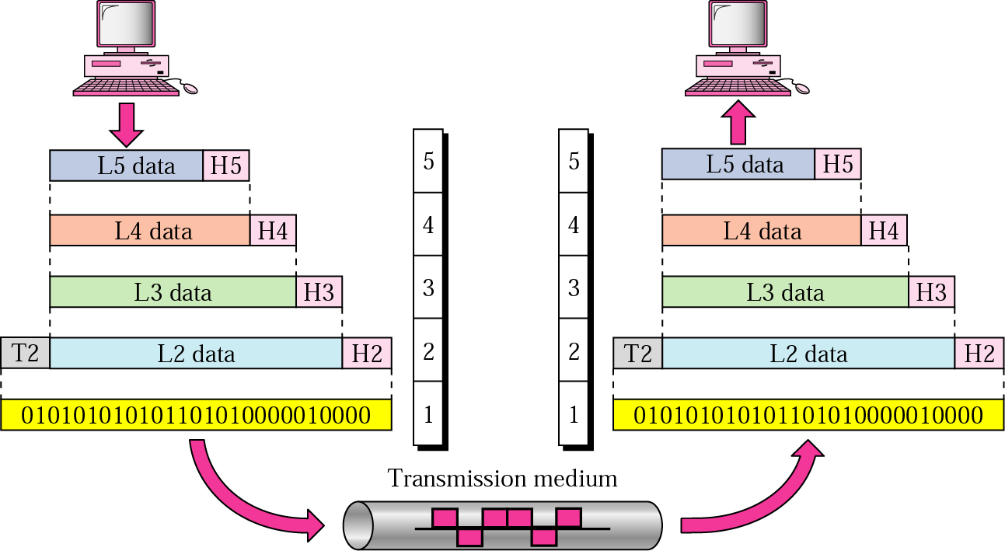

Slide 10









Protocol Data Unit
PDU
Data
Segment
Packet
Frame
PDU Bits and Bytes
010 101011100011010

Slide 12
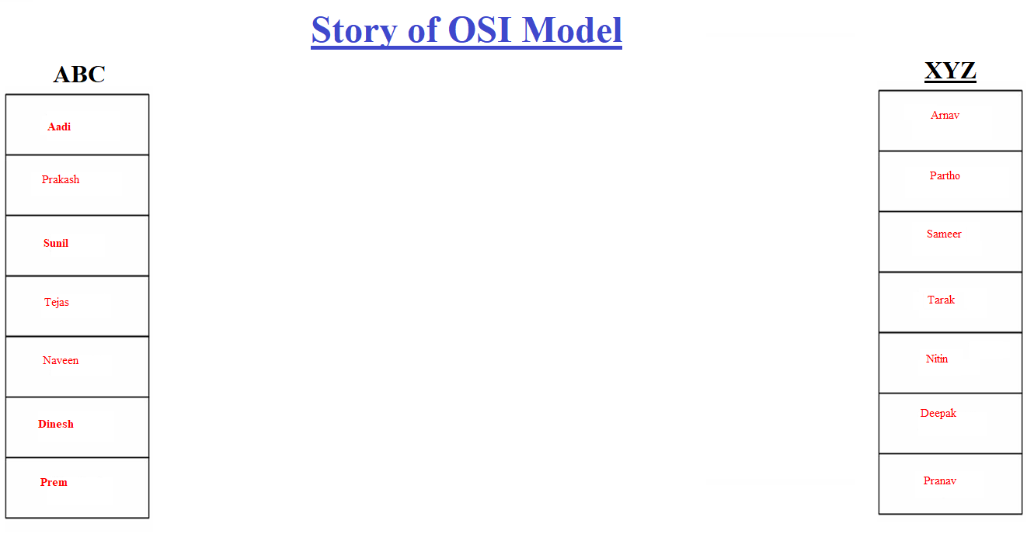
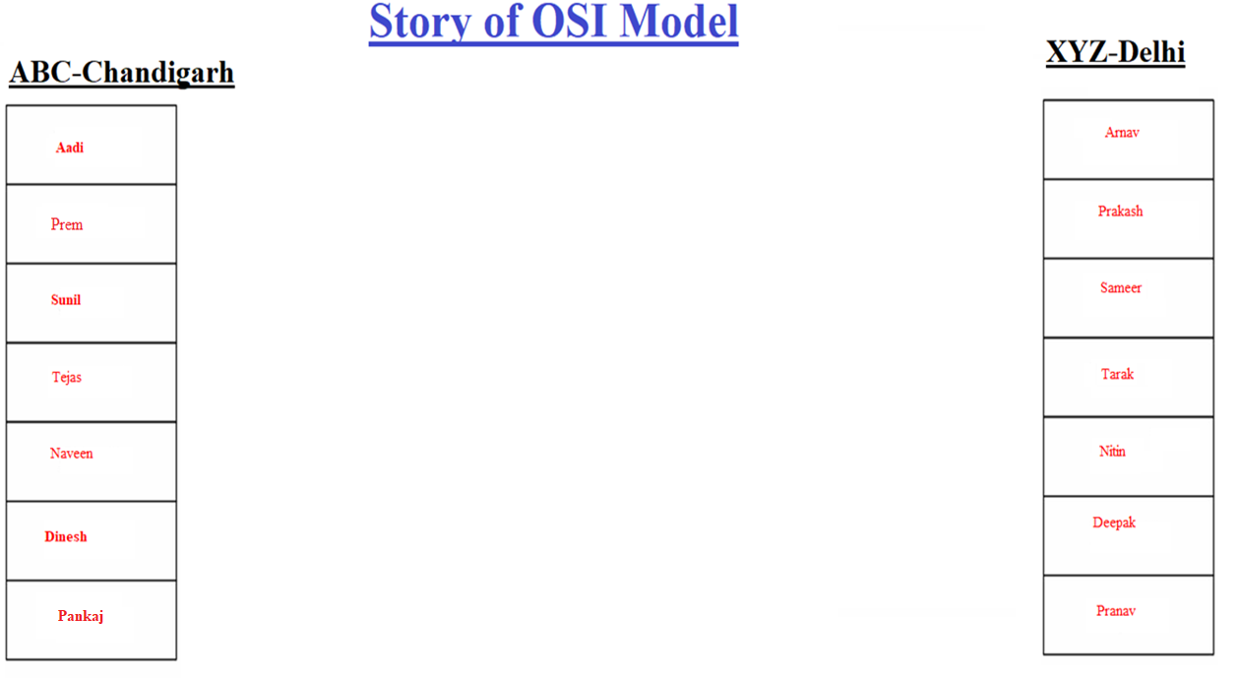

Slide 13


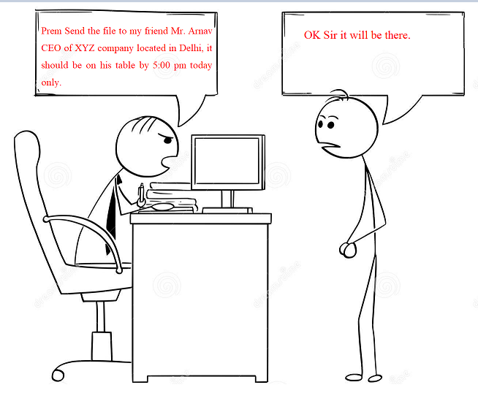

Slide 14


Slide 15
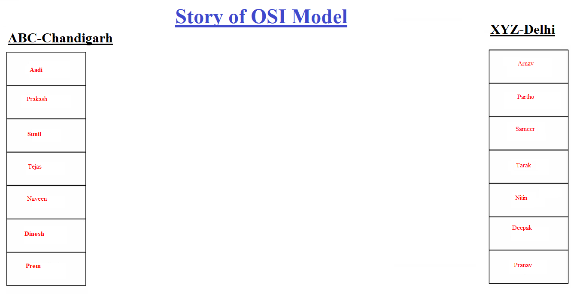
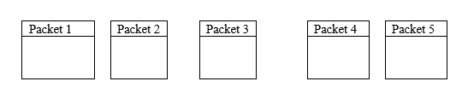

Slide 16
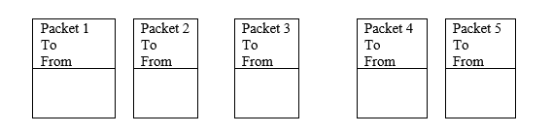

Slide 17
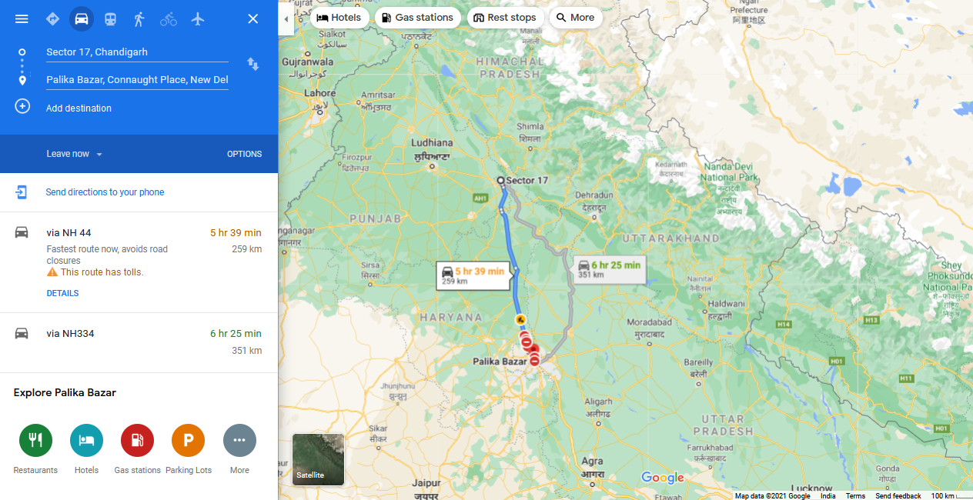

Slide 18


Slide 19


Slide 20



Slide 21


Slide 22
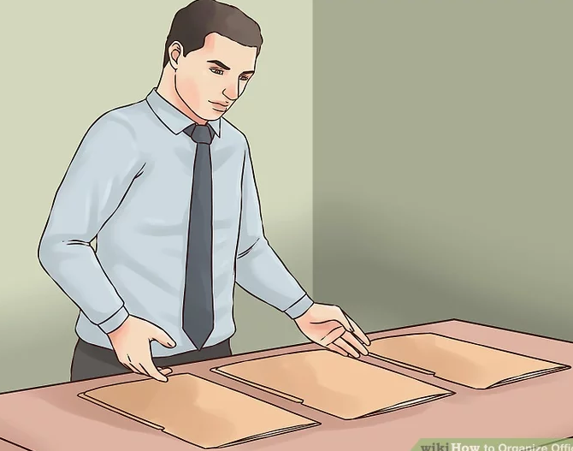
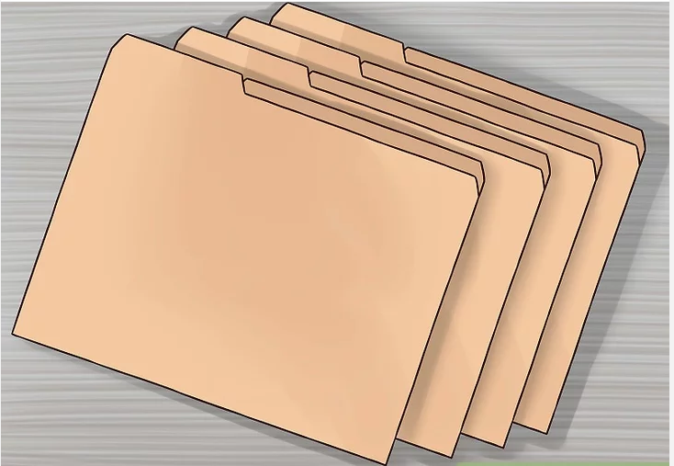

Slide 25
TCP/IP
Transmission Control Protocol (TCP), Internetworking Protocol (IP)
was developed prior to the OSI model.
The original TCP/IP protocol suite was defined as having four layers:
    host-to-network,
    internet,
    transport,
    and application.

Slide 26

TCP/IP

Slide 27

TCP/IP

Slide 28
Subjective Questions
Write a note on OSI Model
Write a note on TCP/IP Model.

Slide 29
Multiple Choice Questions
The process-to-process delivery of the entire message is the responsibility of the _______ layer.
a. Network
b. Transport
c. Application
d. Physical
Mail services are available to network users through the _______ layer.
a. Data link
b. Physical
c. Transport
d. Application
When data are transmitted from device A to device B, the header from A's layer 4 is read by B's _______ layer.
a. Physical
b. Transport
c. Application
d. None of the above

Slide 30
Multiple Choice Questions
The process-to-process delivery of the entire message is the responsibility of the _______ layer.
a. Network
b. Transport
c. Application
d. Physical
Mail services are available to network users through the _______ layer.
a. Data link
b. Physical
c. Transport
d. Application
When data are transmitted from device A to device B, the header from A's layer 4 is read by B's _______ layer.
a. Physical
b. Transport
c. Application
d. None of the above

Slide 31
Multiple Choice Questions
The _______ layer changes bits into electromagnetic signals.
a. Physical
b. Data link
c. Transport
d. None of the above
Which of the following is an application layer service?
a. Remote log-in
b. File transfer and access
c. Mail service
d. All the above
Why was the OSI model developed?
a. Manufacturers disliked the TCP/IP protocol suite.
b. The rate of data transfer was increasing exponentially
c. Standards were needed to allow any two systems to communicate
d. None of the above

Slide 32
Multiple Choice Questions
The _______ layer changes bits into electromagnetic signals.
a. Physical
b. Data link
c. Transport
d. None of the above
Which of the following is an application layer service?
a. Remote log-in
b. File transfer and access
c. Mail service
d. All the above
Why was the OSI model developed?
a. Manufacturers disliked the TCP/IP protocol suite.
b. The rate of data transfer was increasing exponentially
c. Standards were needed to allow any two systems to communicate
d. None of the above

Slide 33
Multiple Choice Questions
The _______ model shows how the network functions of a computer ought to be organized.
a. CCITT
b. OSI
c. ISO
d. ANSI
The physical layer is concerned with the movement of _______ over the physical medium.
a. programs
b. dialogs
c. protocols
d. bits

Slide 34
Multiple Choice Questions
The _______ model shows how the network functions of a computer ought to be organized.
a. CCITT
b. OSI
c. ISO
d. ANSI
The physical layer is concerned with the movement of _______ over the physical medium.
a. programs
b. dialogs
c. protocols
d. bits

Slide 35
Multiple Choice Questions
In the OSI model, what is the main function of the transport layer?
a. node-to-node delivery
b. process-to-process message delivery
c. synchronization
d. updating and maintenance of routing tables
In the OSI model, encryption and decryption are functions of the ________ layer.
a. transport
b. session
c. presentation
d. application
When a host on network A sends a message to a host on network B, which address does the router look at?
a. port
b. logical
c. physical
d. none of the above

Slide 36
Multiple Choice Questions
In the OSI model, what is the main function of the transport layer?
a. node-to-node delivery
b. process-to-process message delivery
c. synchronization
d. updating and maintenance of routing tables
In the OSI model, encryption and decryption are functions of the ________ layer.
a. transport
b. session
c. presentation
d. application
When a host on network A sends a message to a host on network B, which address does the router look at?
a. port
b. logical
c. physical
d. none of the above

Slide 37
Multiple Choice Questions
To deliver a message to the correct application program running on a host, the _______ address must be consulted.
a. port
b. IP
c. physical
d. none of the above
IPv6 has _______ -bit addresses.
a. 32
b. 64
c. 128
d. variable

Slide 38
Multiple Choice Questions
To deliver a message to the correct application program running on a host, the _______ address must be consulted.
a. port
b. IP
c. physical
d. none of the above
IPv6 has _______ -bit addresses.
a. 32
b. 64
c. 128
d. variable

Slide 39
Multiple Choice Questions
The ______ layer is responsible for moving frames from one hop (node) to the next.
a. physical
b. data link
c. transport
d. none of the above
The ______ layer adds a header to the packet coming from the upper layer that includes the logical addresses of the sender and receiver.
a. physical
b. data link
c. network
d. none of the above

Slide 40
Multiple Choice Questions
The ______ layer is responsible for moving frames from one hop (node) to the next.
a. physical
b. data link
c. transport
d. none of the above
The ______ layer adds a header to the packet coming from the upper layer that includes the logical addresses of the sender and receiver.
a. physical
b. data link
c. network
d. none of the above

Slide 41
Multiple Choice Questions
The_________ layer is responsible for the delivery of a message from one process to another.
a. physical
b. transport
c. network
d. none of the above
The ________ address, also known as the link address, is the address of a node as defined by its LAN or WAN.
a. port
b. physical
c. logical
d. none of the above

Slide 42
Multiple Choice Questions
The_________ layer is responsible for the delivery of a message from one process to another.
a. physical
b. transport
c. network
d. none of the above
The ________ address, also known as the link address, is the address of a node as defined by its LAN or WAN.
a. port
b. physical
c. logical
d. none of the above

Slide 43


See you in next class

